Slide 1
CBEM LAB PROJECT
Md Shakhawat Hossain
Walid Al Sibai
Jubayer Islam

Slide 2
Index
Introduction
Kf general equation
Possible g models
Objective
Datasets
Computed Values
2D and 3D Graphs
Deduction

Slide 3
Introduction
The knowledge of the heat flow curve of a material is essential for many calculations in the field of deformation technology. Certain dependencies of the flow tension kf on deformation parameters, like the deformation φ, the deformation speed φ˙ and the temperature T, have been known experimentally for a long time.

Slide 4
kf = g(x, T, φ, φ˙)
Is the general form of the mathematical function expressing the before mentioned dependencies

Slide 5
Some possible choices for the model function g

Slide 6
Objective
Using the optimal parameters on Moodle:
Determine the coefficient of the determination R² for both models
Compare 2 models with 2D and 3D examples

Slide 7
Datasets
C15 Datasheet
1
C60 Datasheet
2
100Cr6 Datasheet
3
Each gives different values of R²

Slide 8
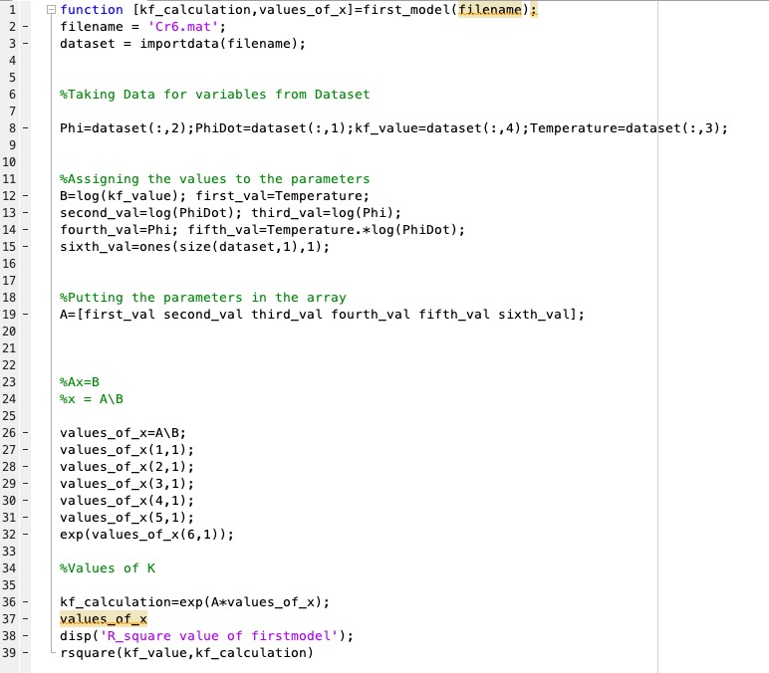
Calculated Values for firstmodel
Ax=B and we get x=A\B
X being a 6x1 matrix has the values:
R² = 0.8648
X
-0.0013
0.0623
0.1520
-0.1681
-0.0001
7.1509

Slide 9
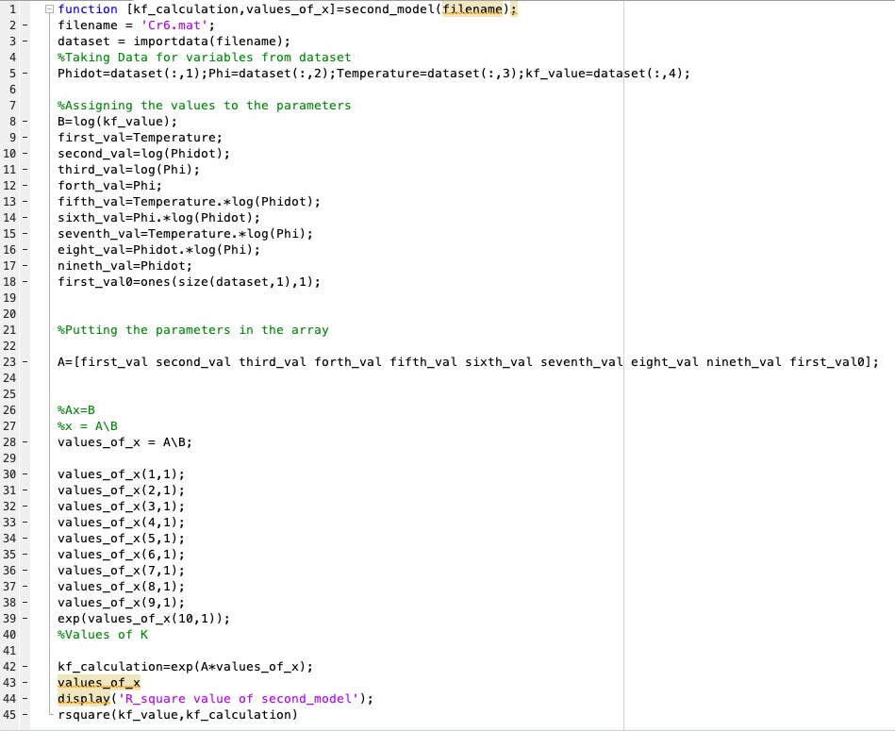
Calculated Values for secondmodel
Ax=B and we get x=A\B
X being a 10x1 matrix has the values:
R² = 0.9385
X
-0.0016
0.0820
0.2586
-0.0297
-0.0001
-0.0521
-0.0003
0.0008
0.0010
7.2278

Slide 10
Results of R squared
Model (1)= 0.8648
Model (2)= 0.9385

Slide 11
2D Graphs
T and φ˙ are set as constants as they vary the least often in the given datasets

Slide 12
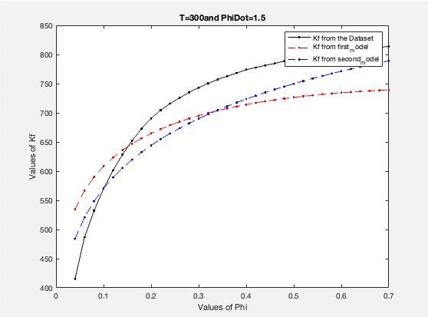

Slide 13
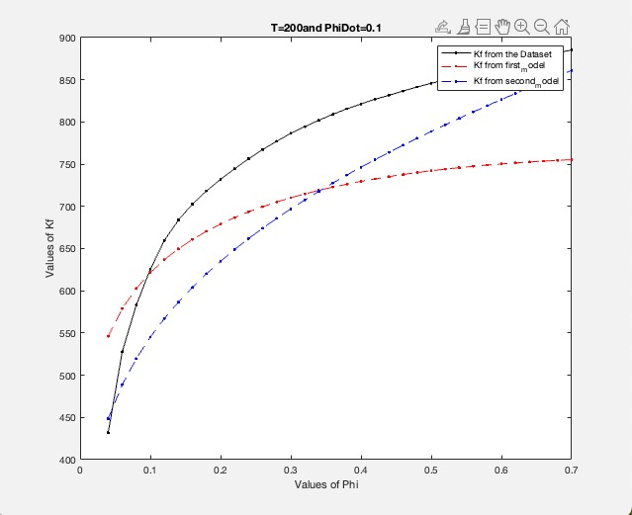

Slide 14
Deduction
The values predicted by the first model is temped to be separated from the Kf value but is intersects at the beginning
The values predicted by the second model is temped to be closer to the Kf value.

Slide 15
3D Graphs
φ˙ is set as constant as it varies even less than then T in the given Datasets

Slide 16
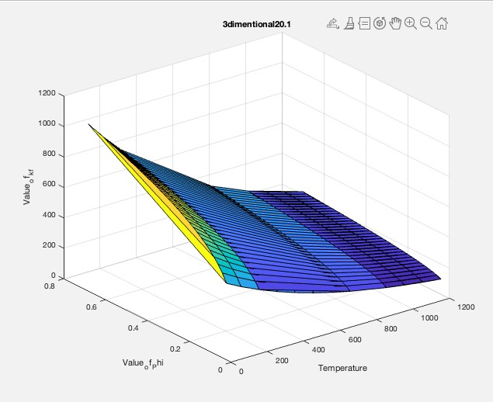
0.1

Slide 17
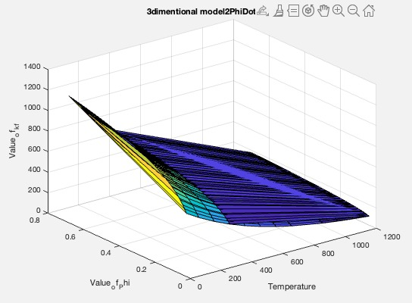
1.5

Slide 18
Deduction
When φ values are higher
When φ values are lower
The values predicted by secondmodel are closer to the Kf values of the dataset
The values predicted by firstmodel are closer to the Kf values of the dataset

Slide 19
Thank you for your attention!

